Slide 1
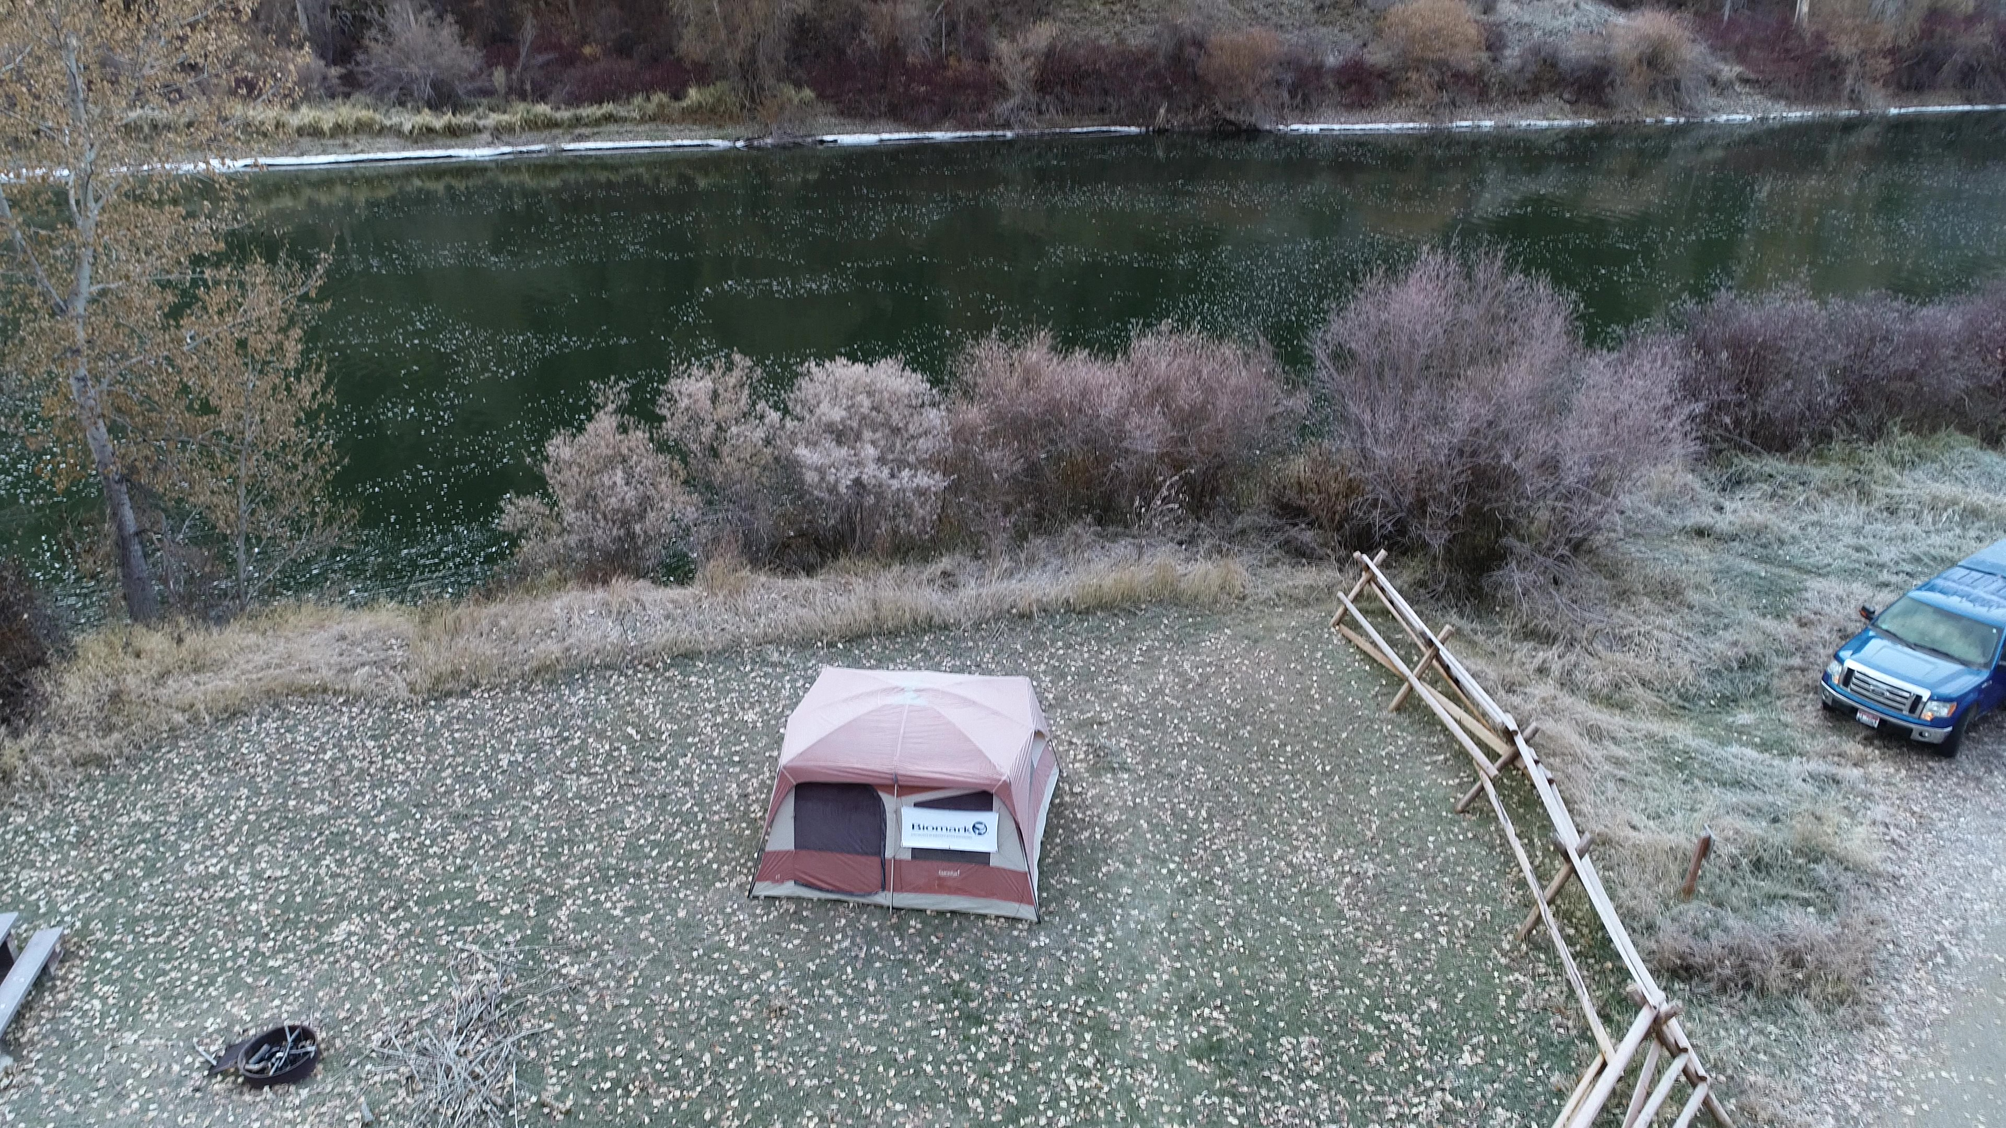
Deadwater Predator Assessment
Braden Lott
Kevin See
Mike Ackerman
RTT
January 8, 2020

Slide 2
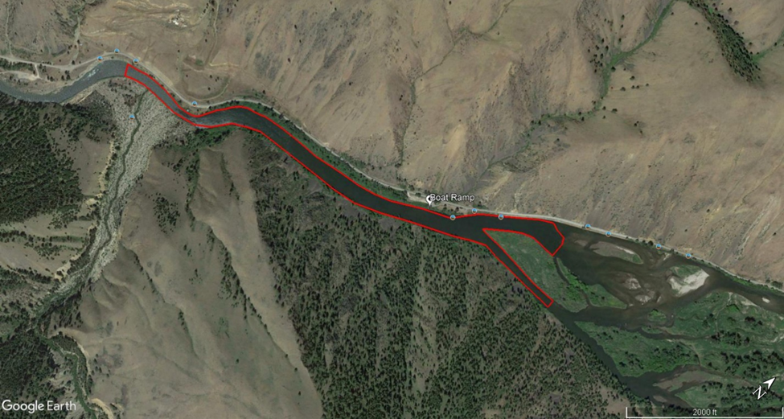

Introduction: Deadwater Slough
Reach from Dump Creek and upstream to ~2km
About 1897 dam failure from mining operations on Dump Creek
Now recognized as an important bird watching and nesting area
Created favorable conditions for piscivorous fish predators
Radio-telemetry studies found a significant decrease in survival

Slide 3
Objectives
Estimate populations for piscivorous fish
Presence/absence for other fish species
Estimate fish consumption on chinook smolts
Presence/absence of nesting areas and/or birds
Potential impact on adult returns

Slide 4
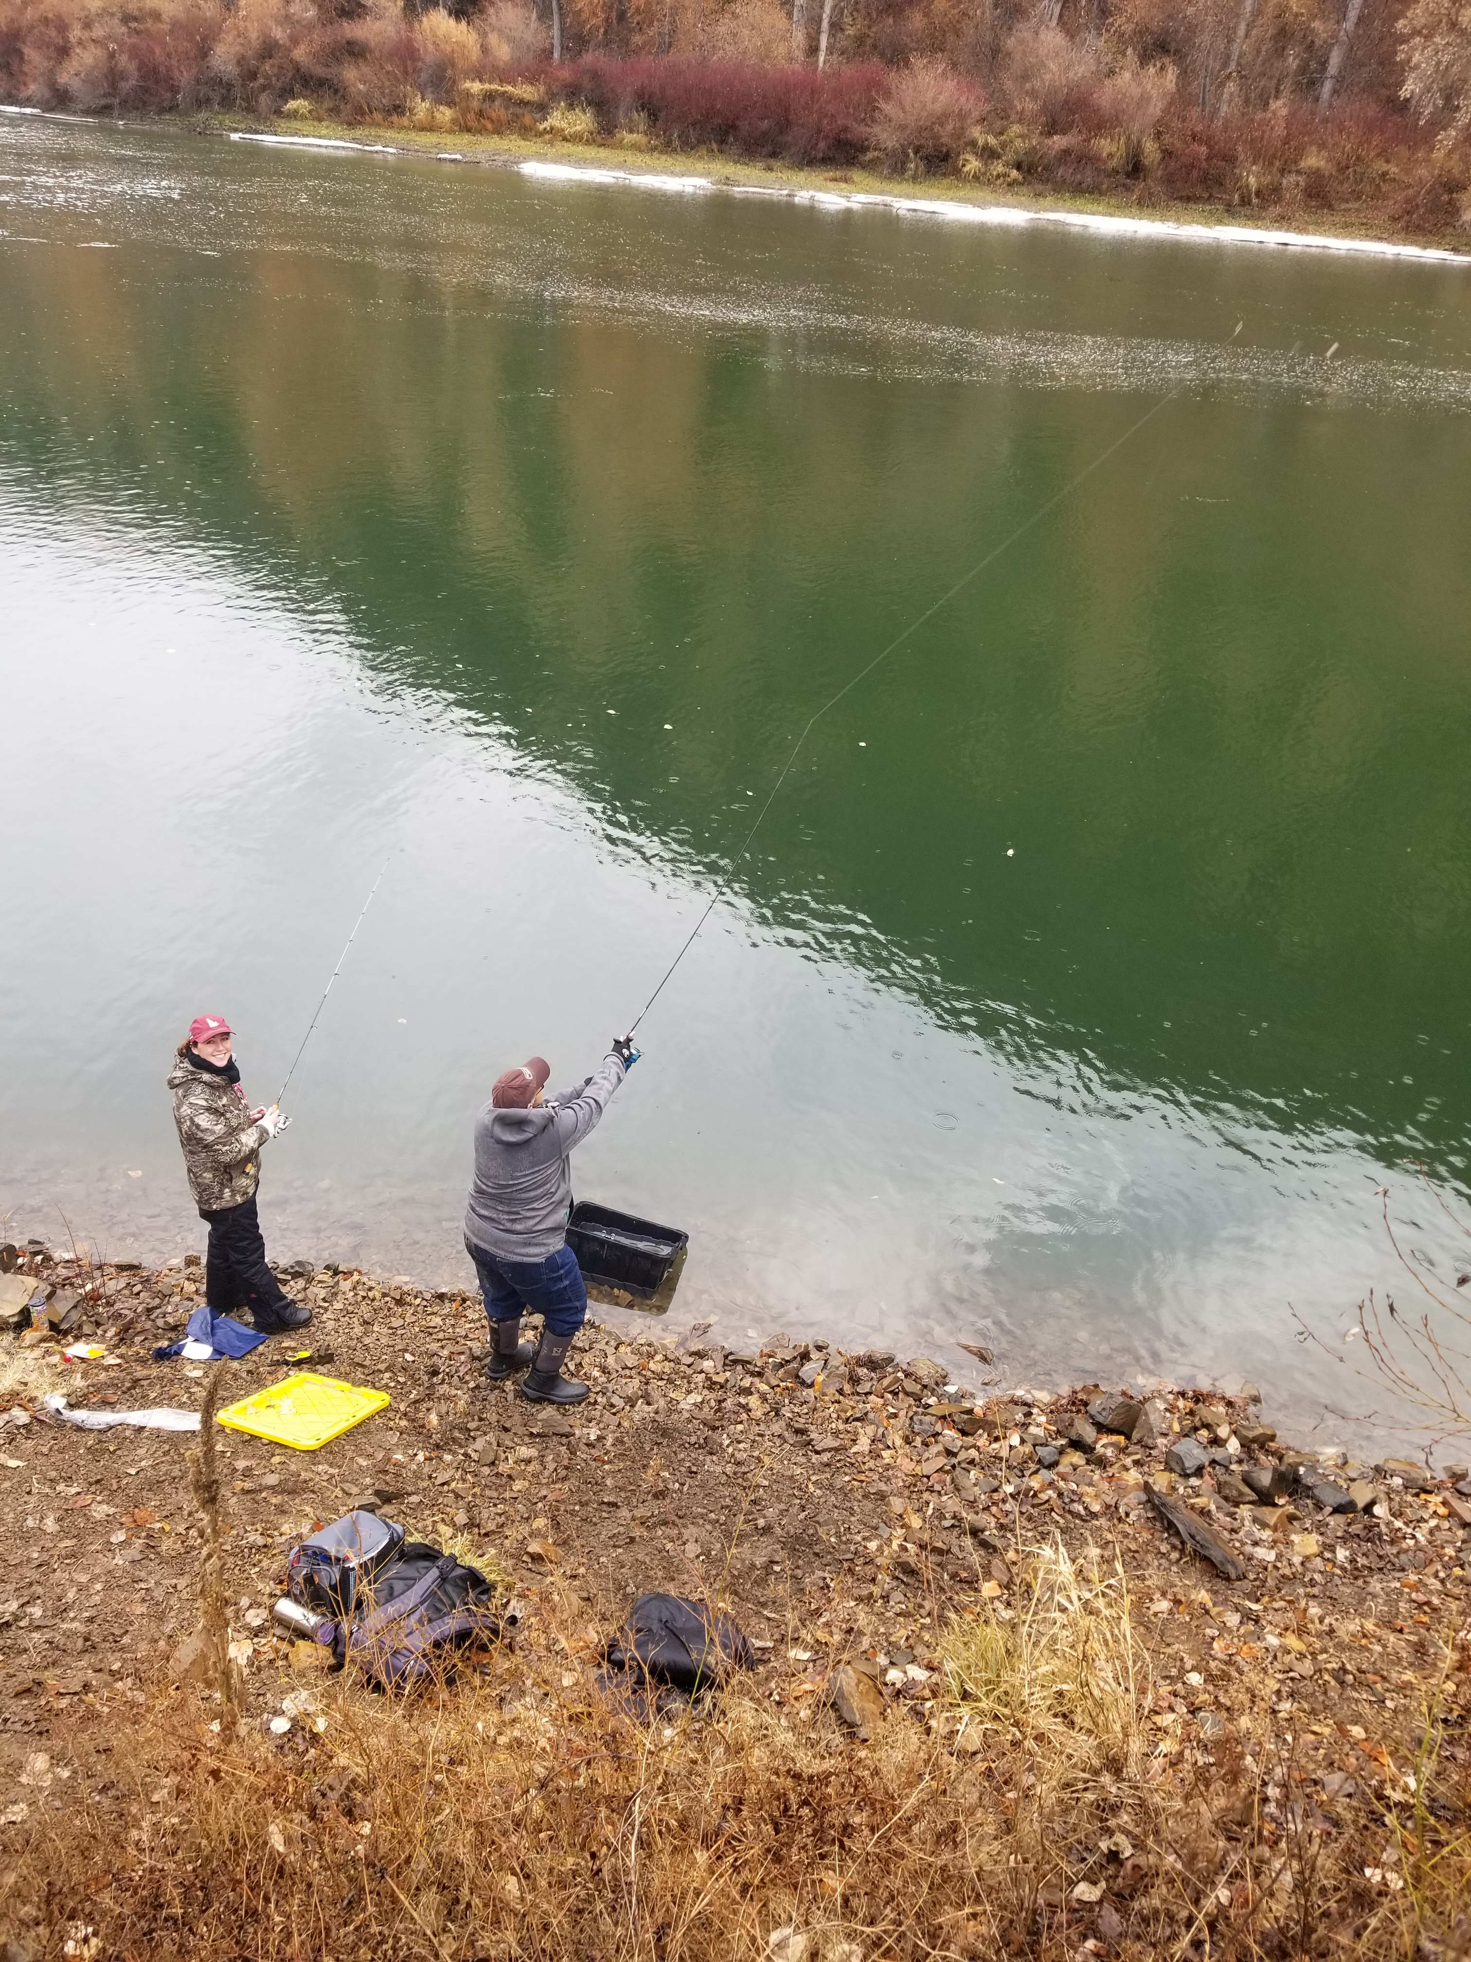
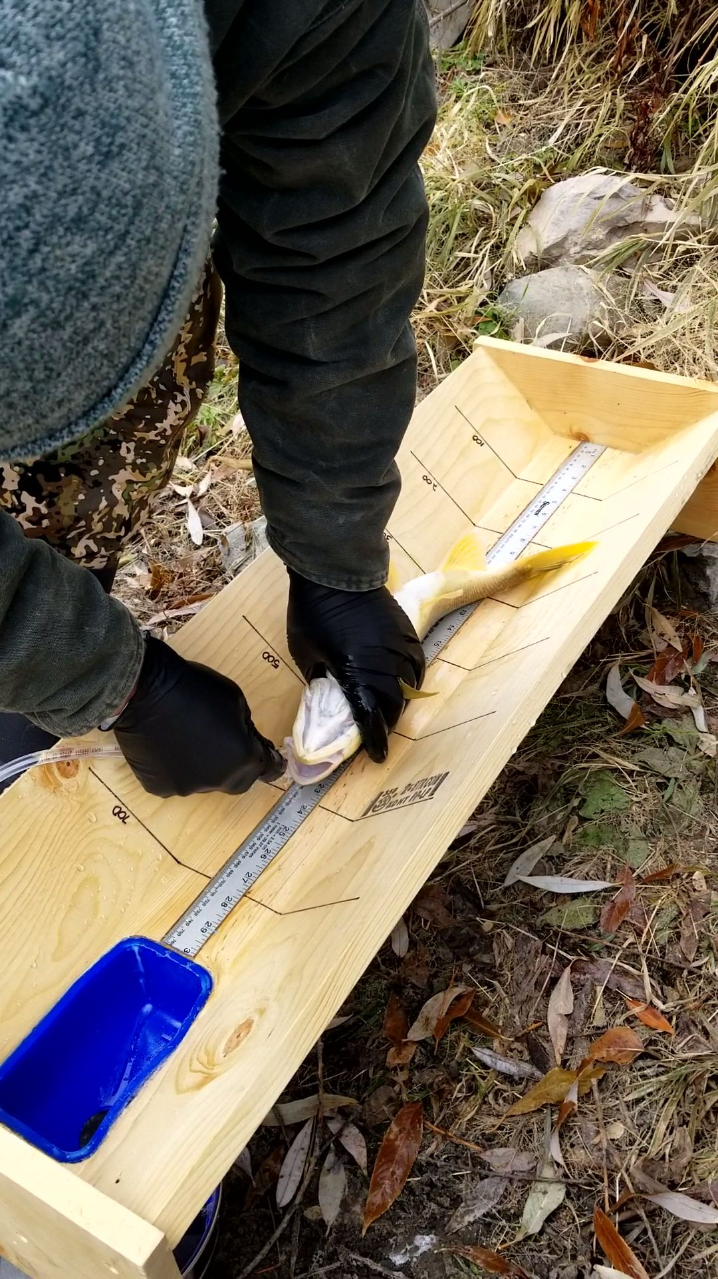
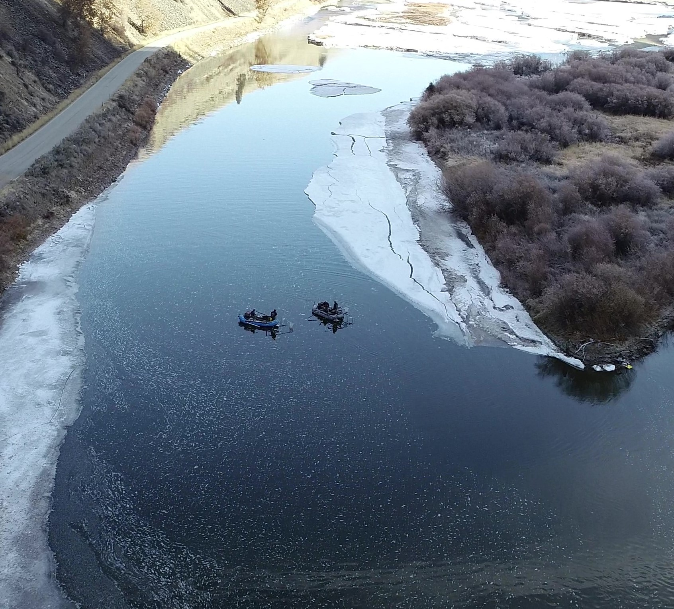
Methods: Fish Capture
Primary method: angling
- variety of gear
- focused on size classes that can feed on a smolt
Secondary methods: electrofishing and snorkeling
Mark/recapture over a 6 day period
Fin clip all individuals with a clip unique to the day
- Schnabel
- Chapman
Measured total length (TL)
Trout species checked for PIT tags
Gastric lavage all captured individuals
Total effort: 8 to 13 individuals

Slide 5
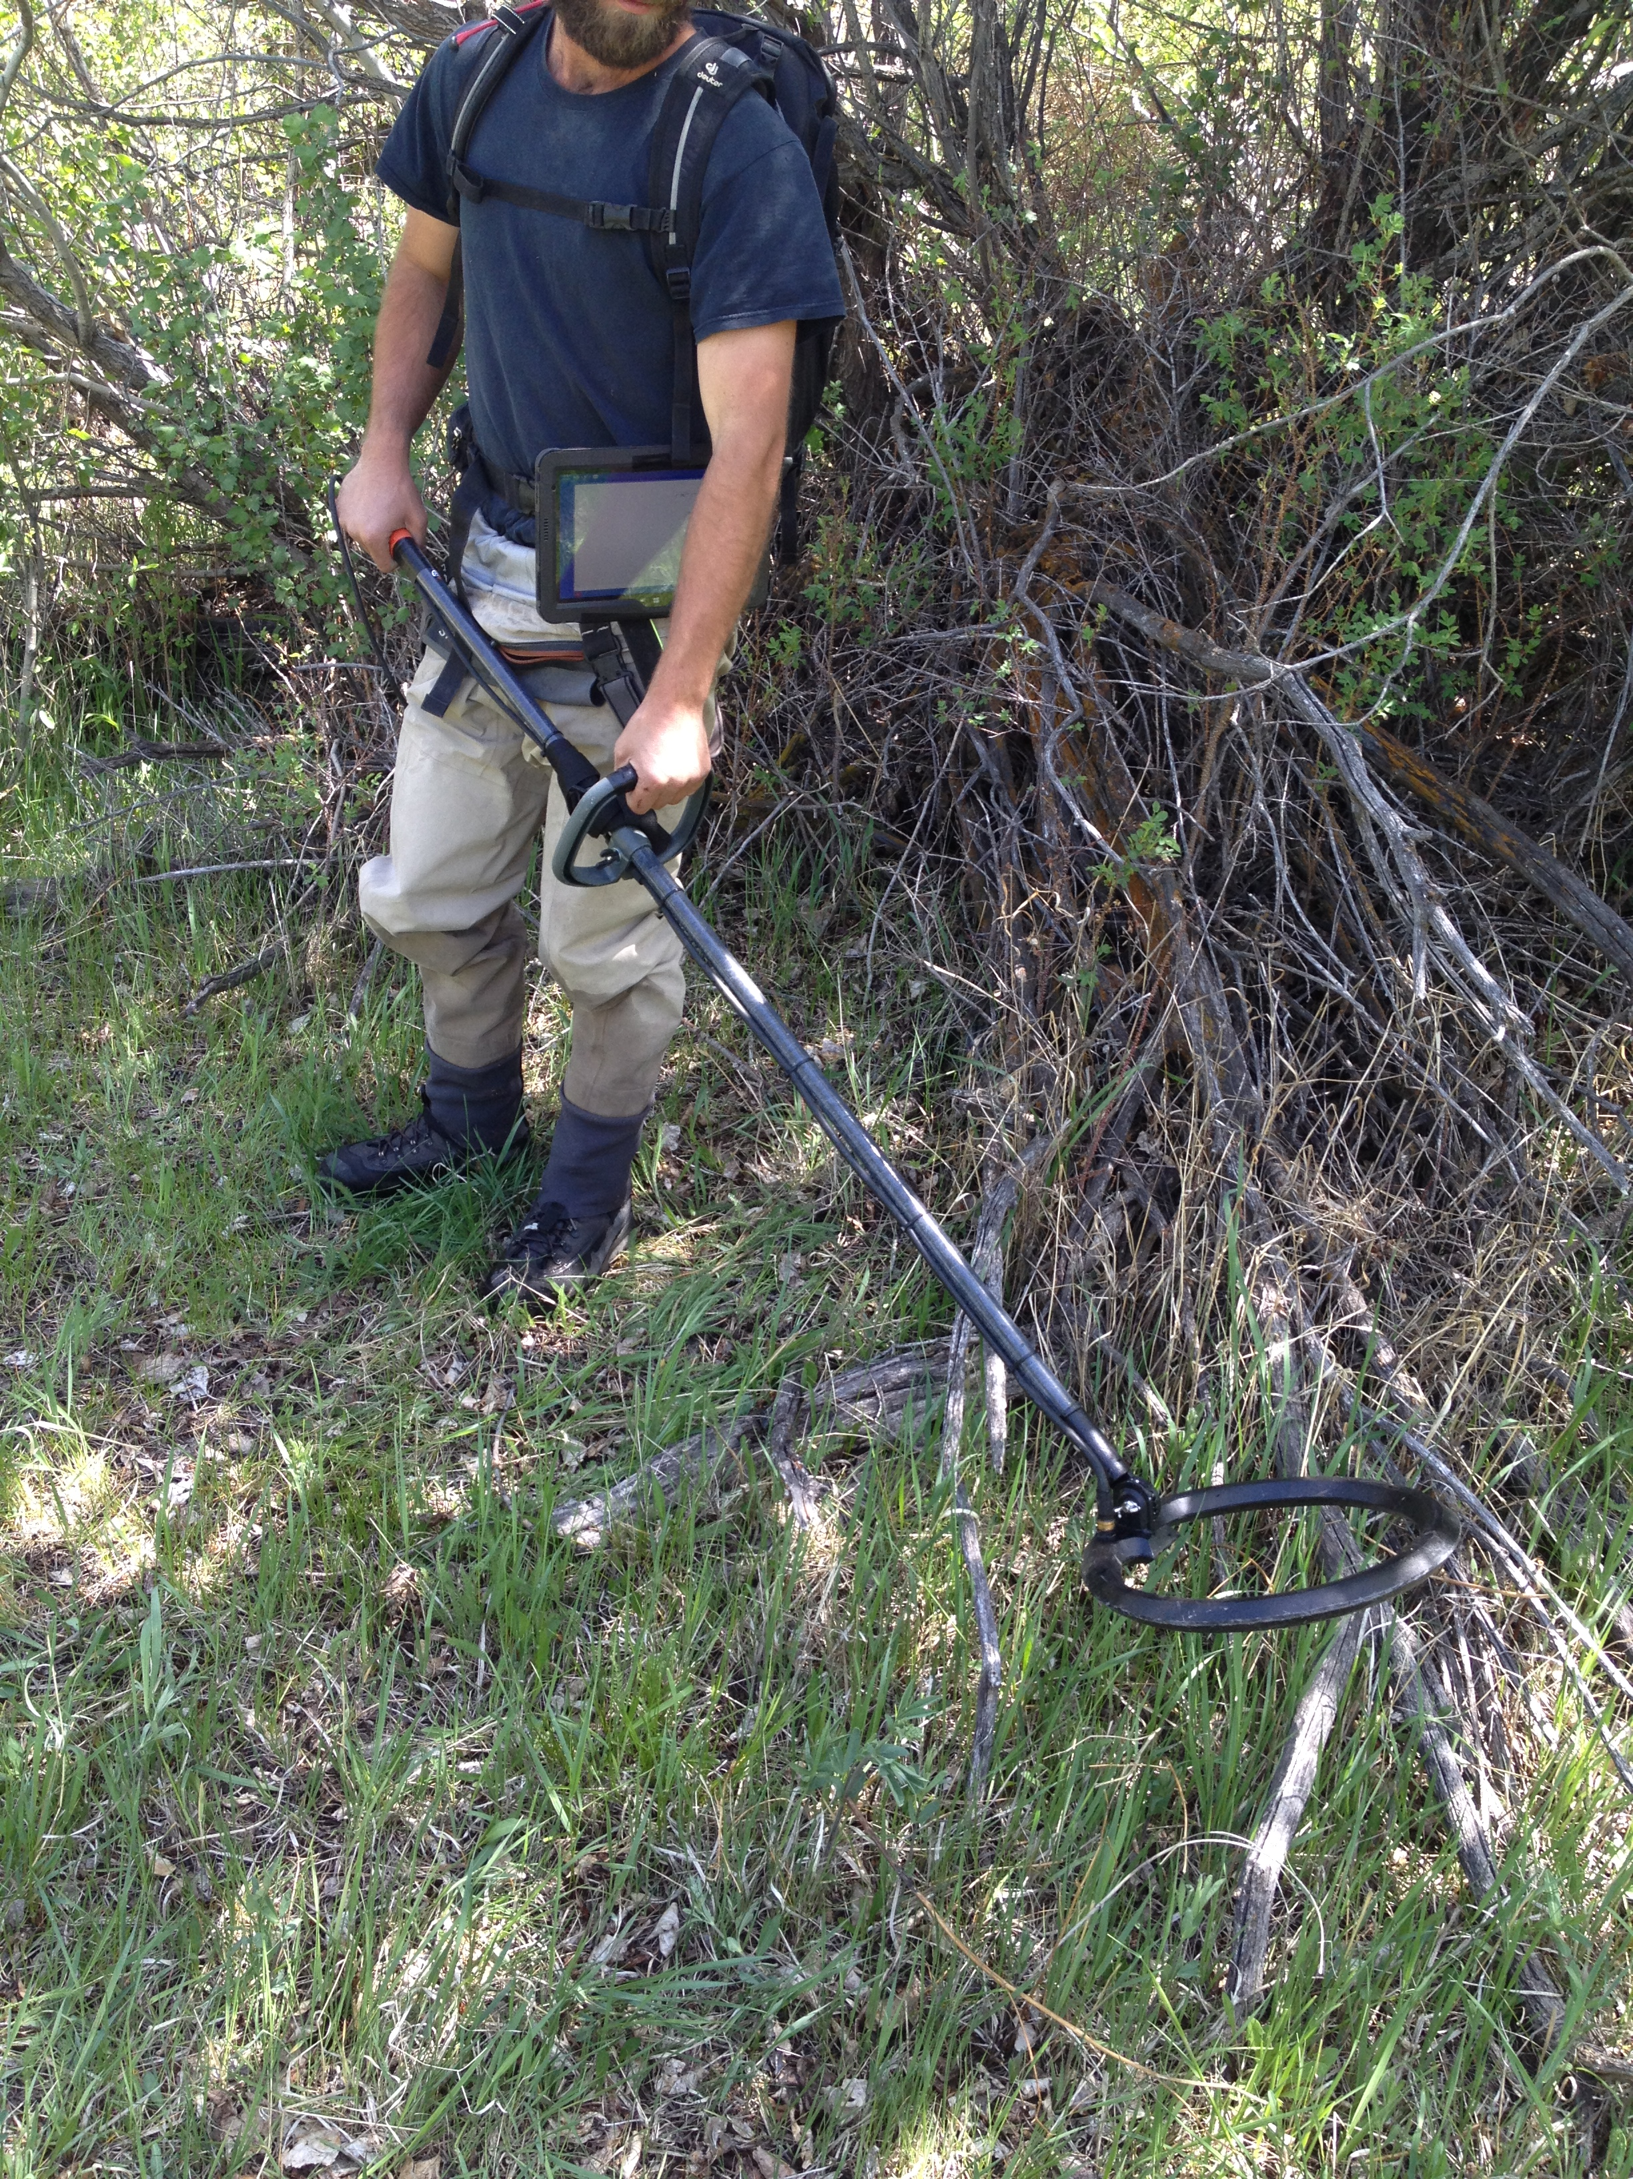
Methods: Avian Predation
Crew of two
Mobile PIT tag antenna, GPS, QST_Datalogger
Scanned under trees, nests, perched birds, islands and banks
Georeferenced sited areas

Slide 6
Results: Fish Abundance
Week 1 lumped together for the mark event
Week 2 lumped together for the recapture
Chapman estimate
No recapture event for electrofishing

Slide 7
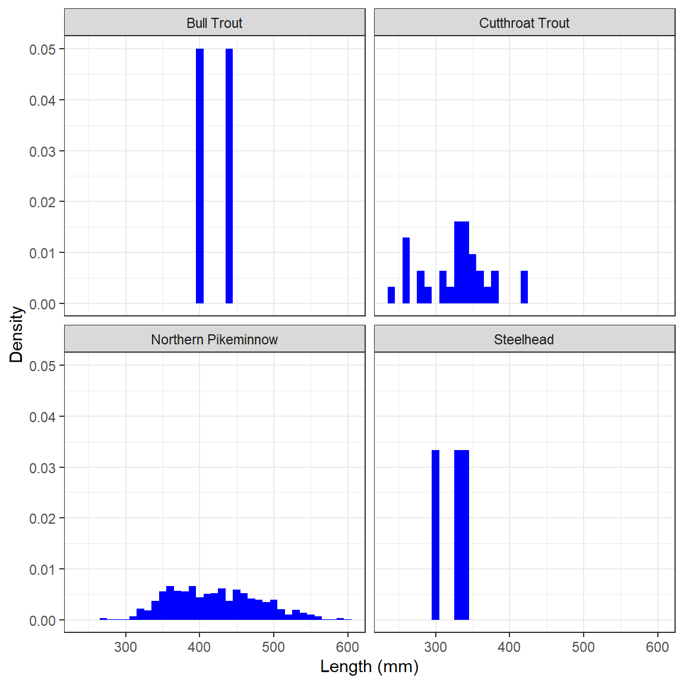
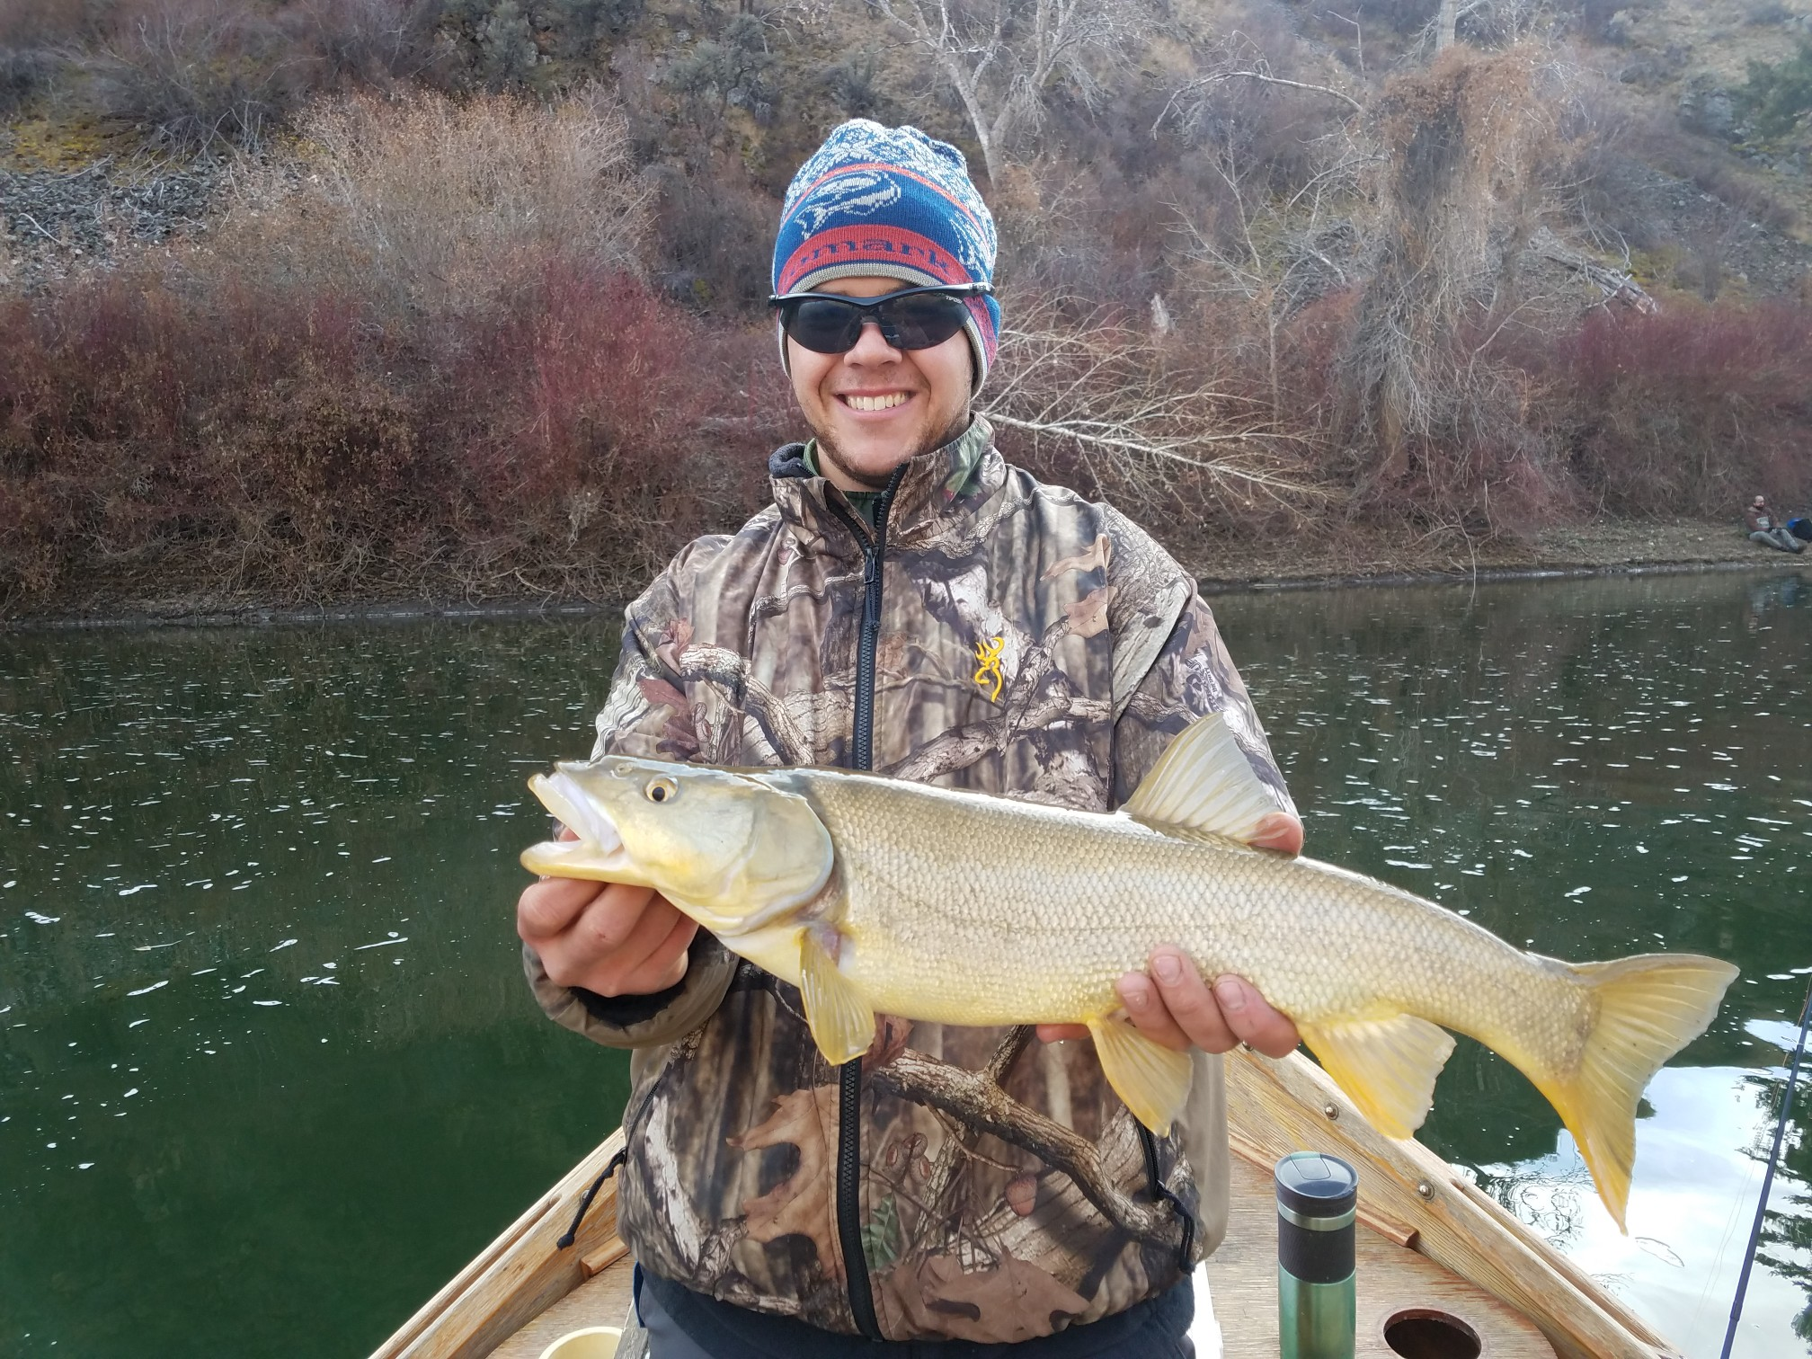
Results: predator size
Largest pikeminnow 604 mm (23 ¾ inches)
Smallest 266 mm
Average pikeminnow 422 mm
Idaho state record is 25.25 inches from 2004 found in the Snake River
Steelhead most likely resident O.mykiss

Slide 8
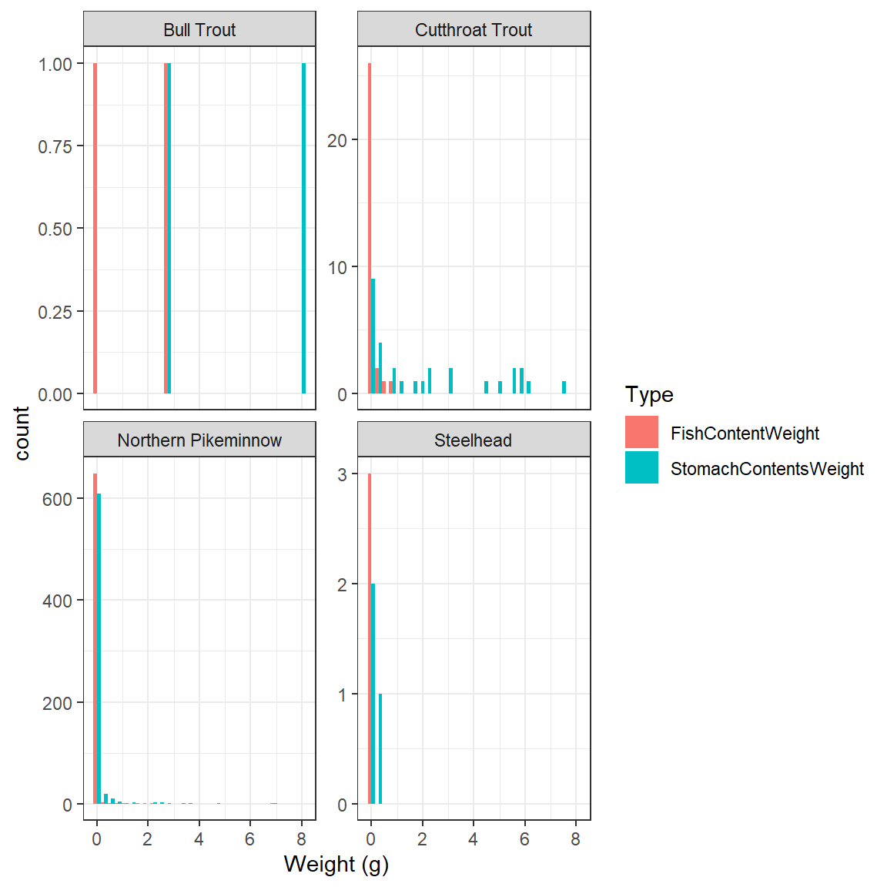
Results: predator diet
692 samples
610 empty
82 with content
17 with unknown fish parts
66 individuals euthanized for dissection

Slide 9
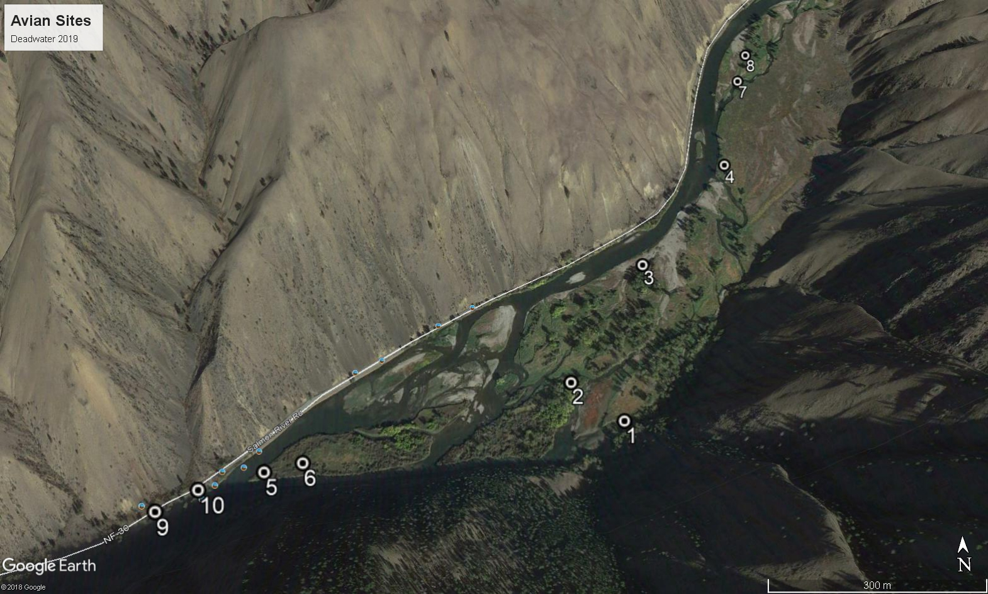
Results: Avian survey
Most sited areas upstream
10 unique tags
Bald Eagles
No downstream resights

Slide 10
Impacts on Adults
Estimate consumption of average sized pikeminnow
Determine length of feeding window
Determine average size of a smolt
Divide consumption by average smolt size
Multiply by total abundance of pikeminnow
Make assumptions on proportions of diet consists of smolt
Translate smolt juvenile abundance to adult abundance using estimates of smolt to adult returns (SAR Granite-to-Granite)

Slide 11
Consumption: Fish Bioenergetics 4.0 from Deslauriers et al. (2017)
Temperature: fixed at 4 degrees C; empirical from Deadwater tidbit
Predator energy density: pikeminnow 6703 J/g (included in the bioenergetics model)
Prey energy density: juvenile chinook 21,500 J/g (Moss et al. 2016)
Period of time: 91 days from Sept 1 through Nov 30
Weight: average pikeminnow 422 mm translates to 1255.2 g using the length/weight equation from the FSA package (sourced from Parker et al. 1995)

Slide 12
Results: Impacts on Adults
Model 1: Temperature was constant 4 degrees C; no growth
Model 2: Temperature variable using empirical data (20 to 0 degrees C); no growth
Constant temp averaged lower than empirical
Average smolt weight 13.8 g; lower Lemhi RST
SAR generate from DART; used the median 1995 to 2015
Model | Equv. Smolt Consumed | SAR | Lifestage | 20 % | 50 % | 80 %
1 | 114,363 | 0.00614 | Smolt | 22,873 | 57,181 | 91,490
2 | 241,580 | 0.00614 | Smolt | 48,316 | 120,790 | 193,264
1 | 114,363 | 0.00614 | Adult | 141 | 351 | 562
2 | 241,580 | 0.00614 | Adult | 297 | 742 | 1,187

Slide 13
Results: Caveats and Assumptions
Predator and prey energy densities are accurate
Average predator weight is estimated accurately
Average sized presmolts from the Lemhi representative of overall pop (conservative)
Pikeminnow pop. size (biomass) is stable
Assumed 20%, 50%, and 80% for chinook consumption. (do not have good information on actual prop.)
Survival from Deadwater to lower Granite is 100% (overestimate)

Slide 14
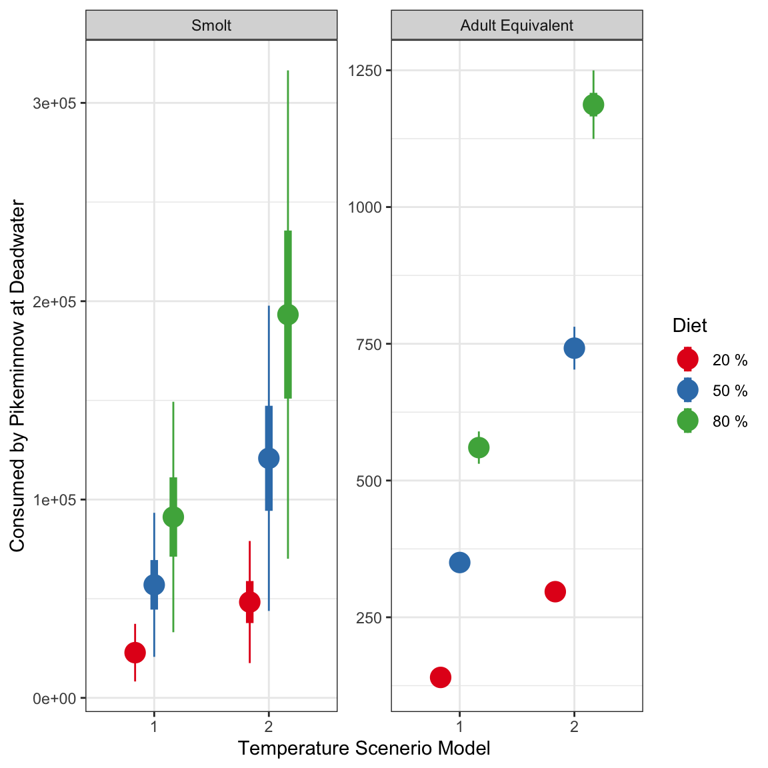
Results: Impacts on Adults

Slide 15
Discussion
Deep, wide, and had little habitat features
Successful at obtaining estimates from angling
Angling may have biased for fish with empty stomachs
Enzymatic activity for poikilotherms were low
Electroshocking was limited by the depth of the area and timing
Snorkeling was limited by the depth and visibility
- saw large amounts of juvenile shiners
- some O.mykiss
- 1 juvenile Chinook
Avian results were successful in identifying predation on fish but magnitude is unclear
- birds can move several miles
- data limited to just PIT tagged individuals
Adult impact of 5 – 20% towards recovery goals
- average escapement is 2500 past deadwater
- 10 to 50% impact to current adult escapement

Slide 16
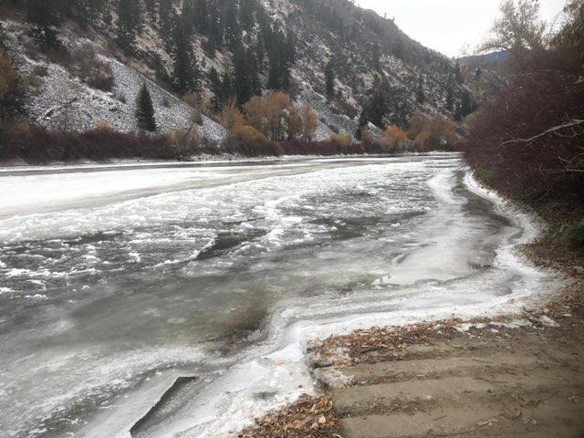
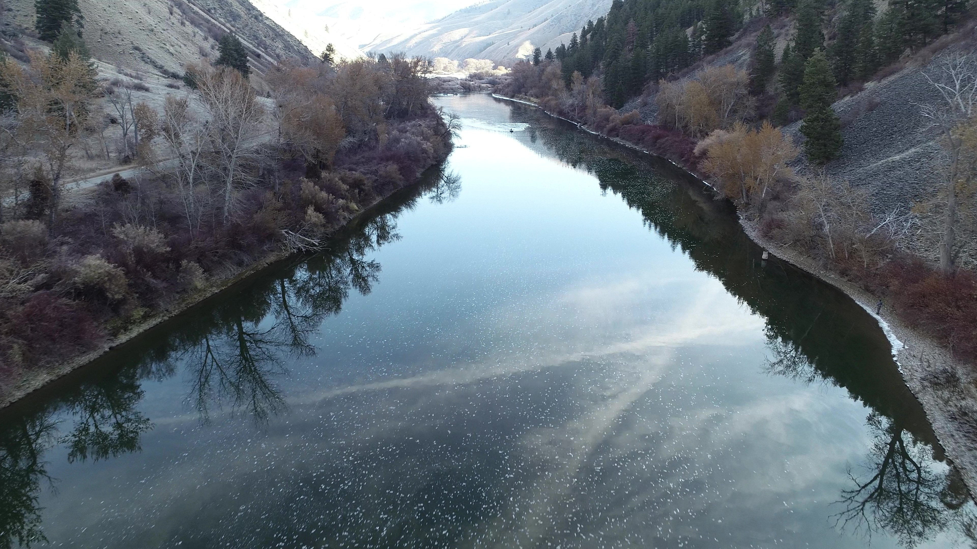
Was almost a bust….
10/31
11/11

Slide 17
Acknowledgements: Special thanks to the individuals and agencies that participated in sampling!
BoR: Brian Hamilton, Mitch Mumma, Bergin Parks, Colby Clifford, Dave Mcdonald, Jason Hewitt, Scott Cooper, Heather Cagle, Lori Rice, and Bill Roberts
IDFG: Stacey Feeken, Kayden Estep, Jonah Keith, Gavin, Bradford, Tucker Hamilton, and Vasili Luzanau
OSC: Chris Gaughan
Land Trust: Jim Roscoe and Louise Bruce
TU: Matt Green and Zane
Regional Tech Team and Daniel Bertram
USGS: Ken Gebhardt and Larry Vogle
Jared Barker and Brian Hamilton for bringing out their personal boats

Slide 18
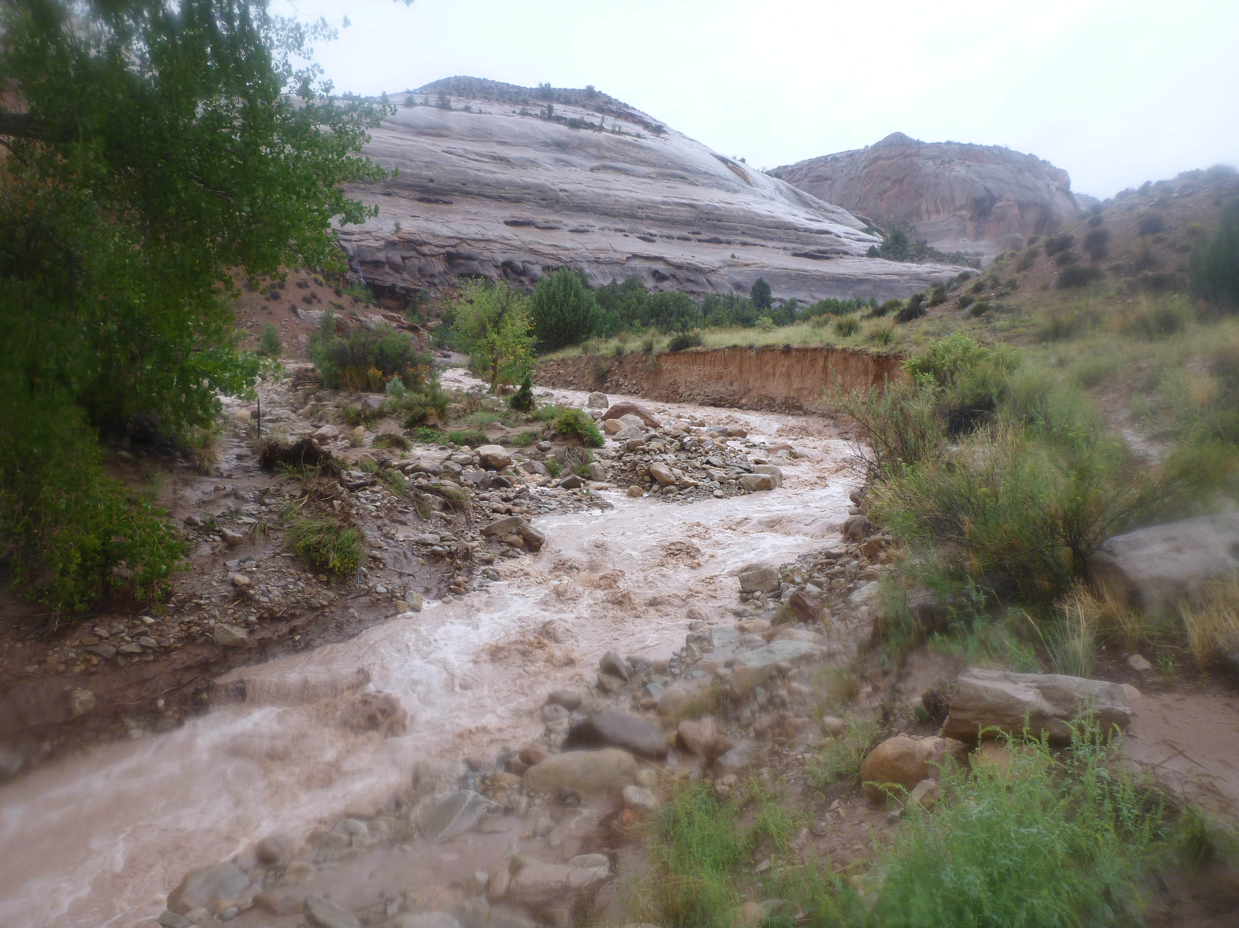
CONTACTS:
Braden Lott
Fisheries Scientist
208-310-9149
Braden.Lott@biomark.com
www.biomark.com

